Slide 1
Microsoft Teams – Use the teamwork Microsoft Graph endpoint
Use Microsoft Graph to post to the activity feed

Slide 2

Overview
Understanding the basics of activity feed notification
Requirements for sending activity feed notifications
Sending activity feed notifications

Slide 3
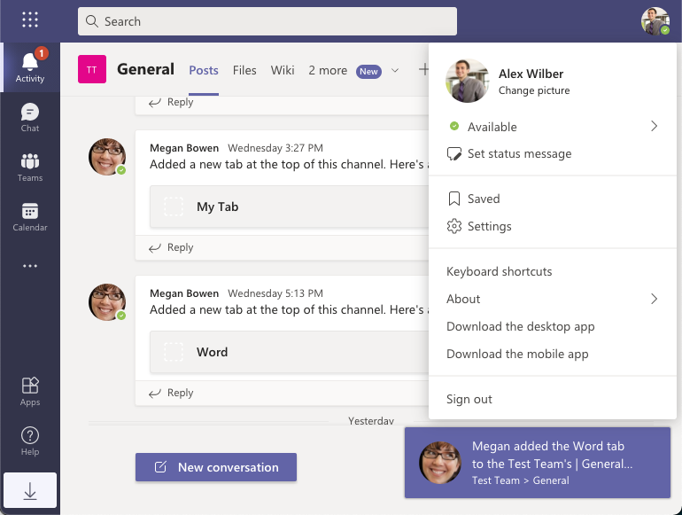
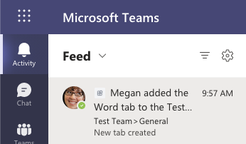
Activity feed notifications
Enables apps to notify users to see relevant items specific to them

Slide 4
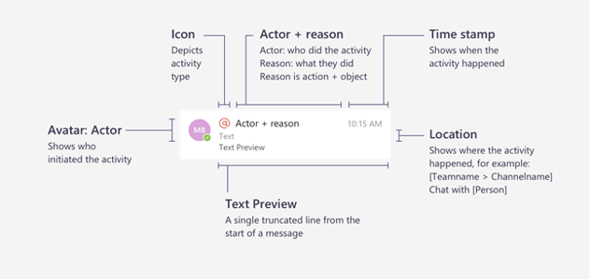
Anatomy of an activity feed notification

Slide 5
Activity feed notification capabilities
notify a user
notify a user in a team
notify a user in chat

Slide 6
Requirements for sending activity feed notifications
Custom Microsoft Teams app must be installed for the recipient of the notification
1
Custom Microsoft Teams app must be associated with an Azure AD app registration
2
Notification activity types must be registered in the custom Microsoft Teams app’s manifest
3

Slide 7
Associate Microsoft Teams apps with Azure AD apps
manifest.json
{
"$schema": "",
"manifestVersion": "1.8",
...
"webApplicationInfo": {
"id": "8a2d385d-8504-43f8-a9b2-80caa44bfe22",
"resource": "api://app.contoso.com/8a2d385d-8504-43f8-a9b2-80caa44bfe22"
}
}

Slide 8
Register the supported activity types
manifest.json
{
"manifestVersion": "1.8",
...
"activities": {
"activityTypes": [
{
"type": "userMention",
"description": "Personal Mention Activity",
"templateText": "{actor} added the {tabName}"
}
]
}
}

Slide 9
HTTP POST https://graph.microsoft.com/v1.0/teams/{groupId}/sendActivityNotification
{
"topic": {
"source": "entityUrl",
"value": `https://graph.microsoft.com/beta/teams/{groupId}`
},
"activityType": "userMention",
"previewText": { "content": "New tab created" },
"recipient": {
"@odata.type": "microsoft.graph.aadUserNotificationRecipient",
"userId": "{recipient-objectID}"
},
"templateParameters": [
{ "name": "tabName", "value": "Word" }
]
}

Slide 10
Demo

Slide 11

Summary
Understanding the basics of activity feed notification
Requirements for sending activity feed notifications
Sending activity feed notifications

Slide 12
Thank you.

